Slide 1
MODEL ARCHITECTURE FOR FEATURE EXTRACTION

Slide 2
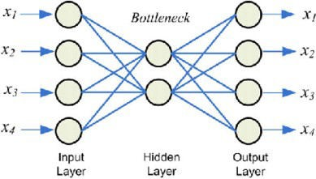
INTRODUCTION
Sparse, Stacked and Variational Autoencoder are used to reconstruct input data.
AUTOENCODER:

Slide 3
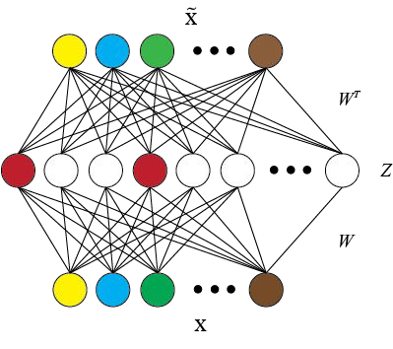
SPARSE AUTO ENCODER

Slide 4
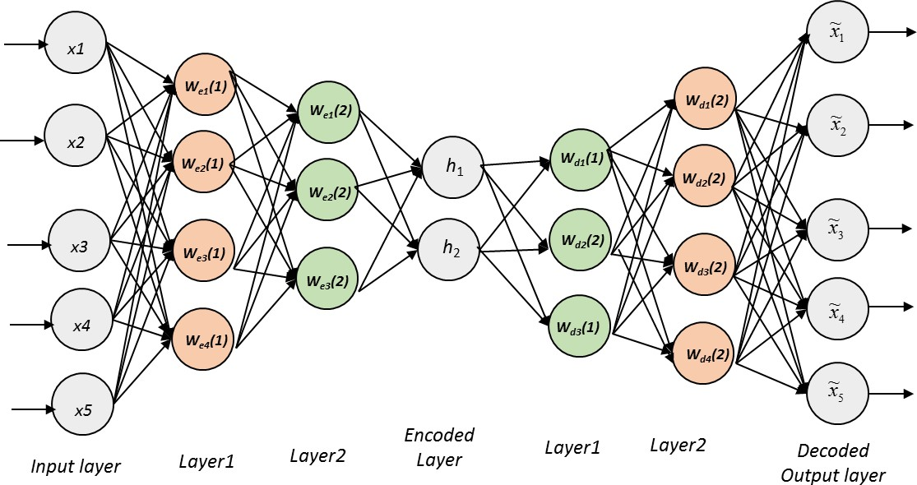
STACKED AUTO ENCODER

Slide 5
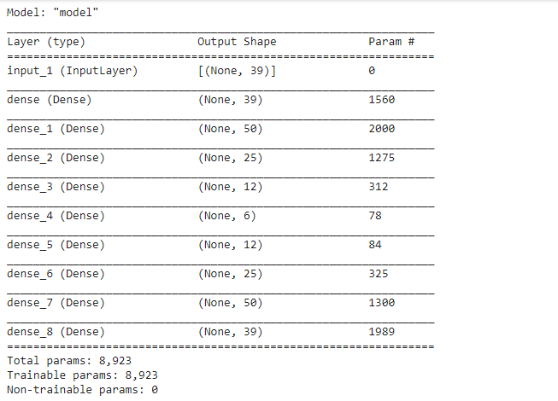
FEATURE ENGINEERING
A stacked encoder model with comparatively smallest number of number of learnable parameters 8,923 is trained over just few epoch of 5.

Slide 6
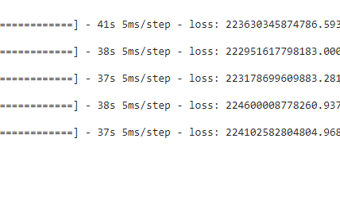

Slide 7
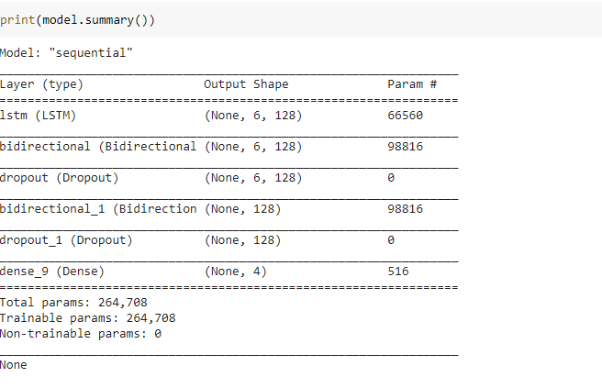
BILSTM
The number of features are quite less in number ,hence the architecture of the BILSTM network demands to have lesser number of parameters.

Slide 8
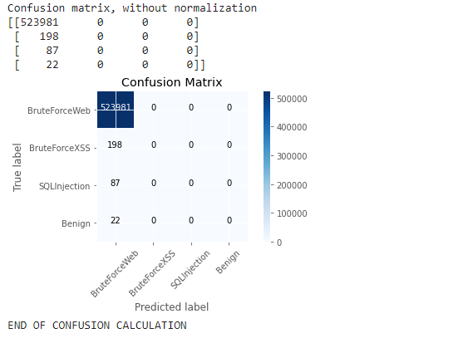

Slide 9
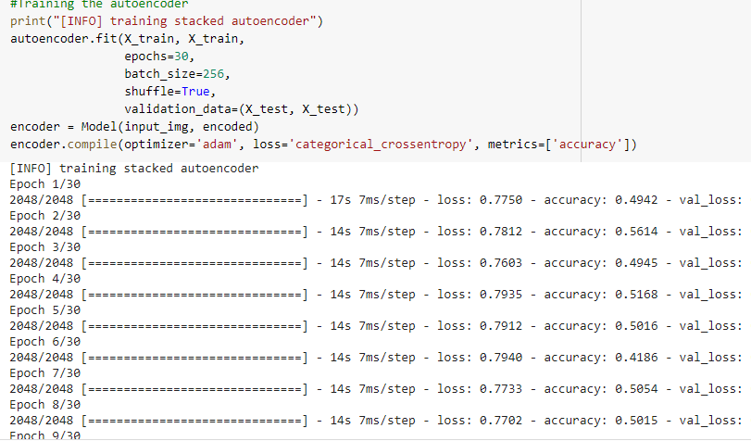
Classification without increasing the data of minority classes (PCA)
A stacked encoder model with 62,552 number of learnable parameters is trained over 30 epoch on 76 features.

Slide 10
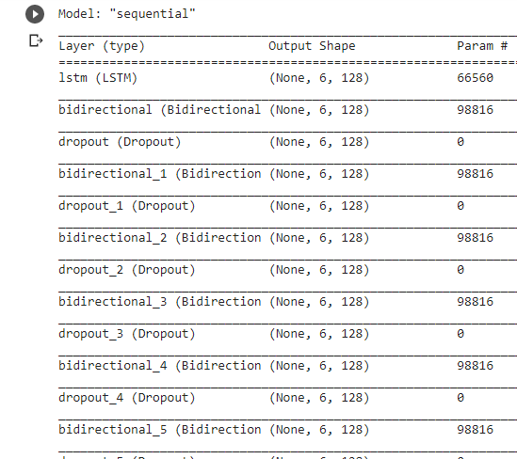
Since the number of features are large in number ,the BILSTM network tends to have large number of parameters . Hence the build architecture have 857,604 learnable parameters.

Slide 11
SMOTE ALGORITHM:
In this classification with the increased data of the minority classes are generated using SMOTE.
A random example from the minority class is first chosen. Then k of the nearest neighbors for that example are found (typically k=5). A randomly selected neighbor is chosen, and a synthetic example is created at a randomly selected point between the two examples in feature space.

Slide 12
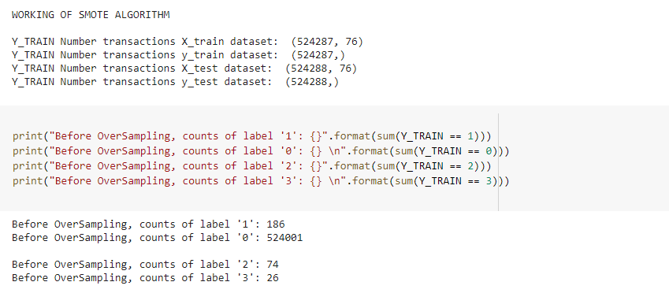
New synthetic data samples are generated first using SMOTE algorithm to overcome data imbalance problem. A stacked encoder model with large number of number of learnable parameters 62,552 is trained over 40 epoch.

Slide 13
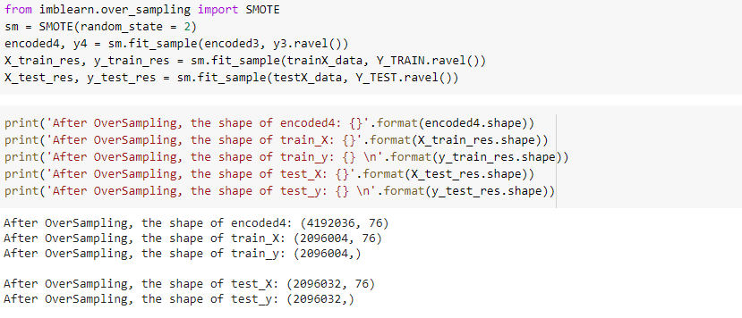
The number of parameters and epoch are large in number because after data creation , we are left with almost 4 times the number of data samples (from 1000000 to 4000000). For increased datasets, a deep learning model requires a greater number of epoch before it starts convergence.

Slide 14
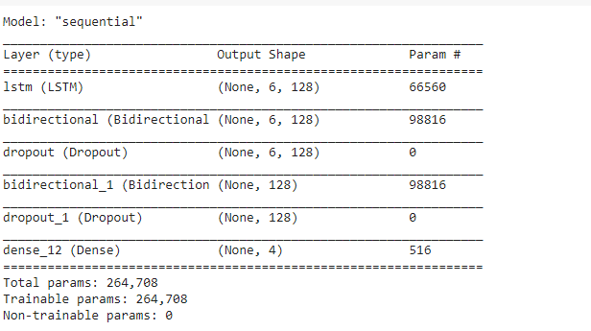
The BILSTM Model is also being initiated. The number of features remained intact even after producing artificial data ,the architecture of the BILSTM demands to have larger number of parameters. Hence the build architecture have 264708 learnable parameters.

Slide 15
 | Learnabl e paramete rs for stacked encoder model | Learnabl e paramete rs for BILSTM network | Number of epoch for stacked encoder model | Number of epoch for BILSTM network
With out increasing data of minority classes | 62,552 | 857,604 | 30 | 1
Feature Engineering | 8,923 | 264,708 | 5 | 1
SMOTE | 62,552 | 264,708 | 40 | 1

